Slide 1

Rockbuster Stealth LLC Streaming Launch Analysis
Niklas Winter March 6, 2023

Slide 2
Overview
Rockbuster Stealth LLC is a movie rental company that used to have stores around the world. Facing stiff competition from streaming services such as Netflix and Amazon Prime, the Rockbuster Stealth management team is planning to use its existing movie licenses to launch an online video rental service in order to stay competitive.

Slide 3
Key Questions
1. Which movies contributed the most/least to revenue gain? 2. What was the average rental duration for all videos? 3. Which countries are Rockbuster customers based in? 4. Where are customers with a high lifetime value based? 5. Do sales figures vary between geographic regions?

Slide 4
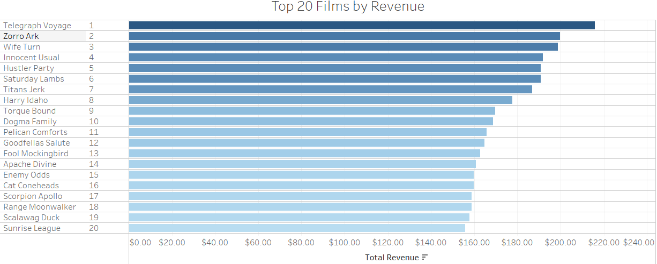
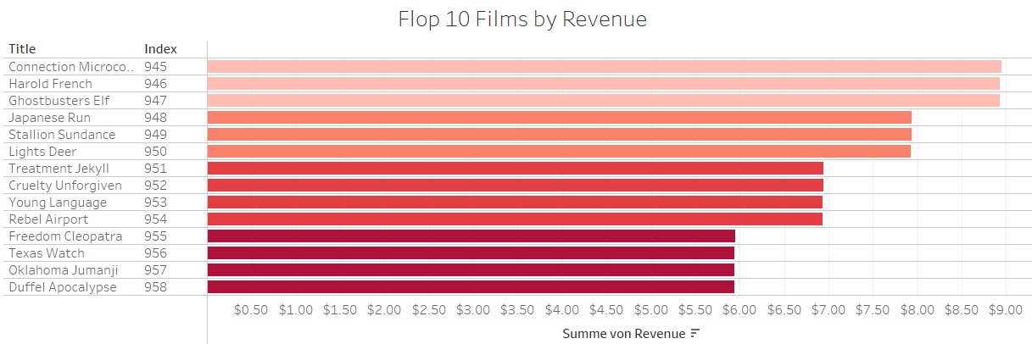
Which movies contributed most/least to revenue gain?

Slide 5
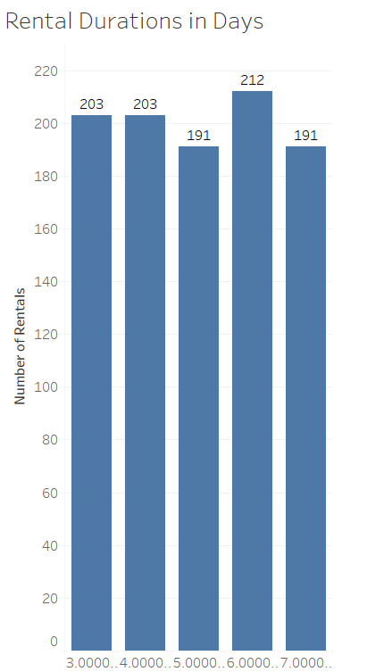
What was the average rental duration for all videos?
All rentals had a duration between 3 and 7 days.
The most common duration was 6 days.
The average rental duration was 4.985 days.

Slide 6
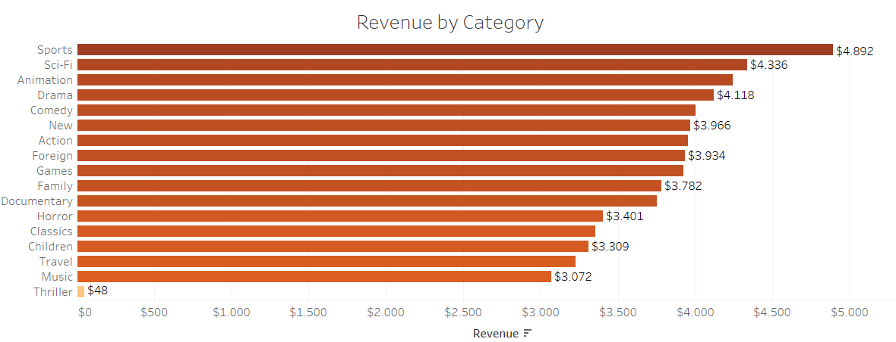
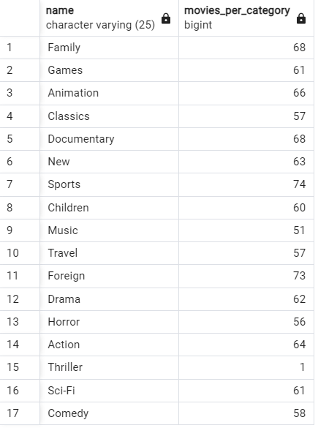
Top Genres by Revenue
All genres, except Thriller (due to the inventory), performe quite solid. The genre Sports generates the highest revenues.

Slide 7
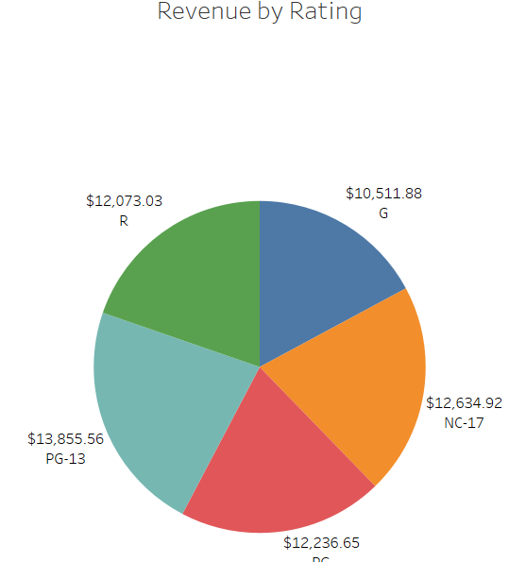
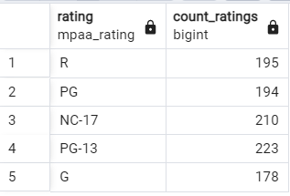
Top Rating by Revenue
PG-13 generated the highest revenue, while G-rated movies generated the lowest revenue.
Considered the Inventory, these results are ot surprising.

Slide 8
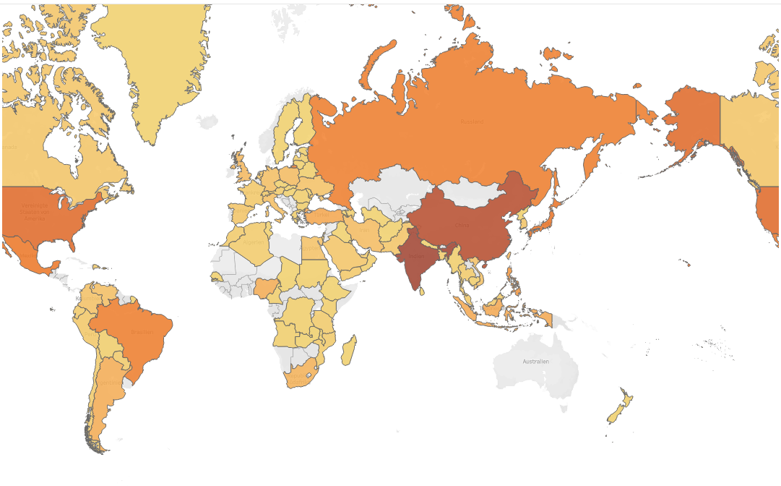
Which countries are Rockbuster customers based in?
The darker the color of the country, the more Rockbuster customers are based in it.
The Top 5 Countries are:
India
China
United States
Japan
Mexico

Slide 9
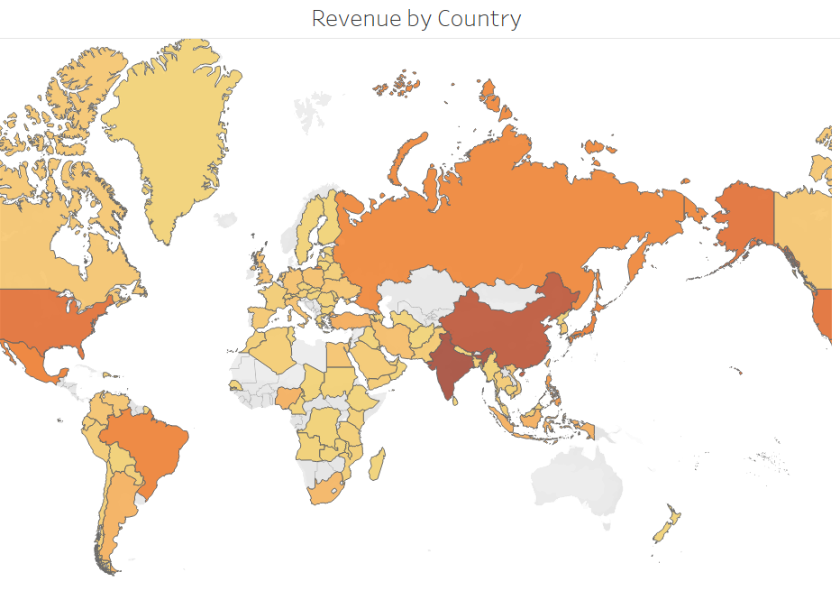
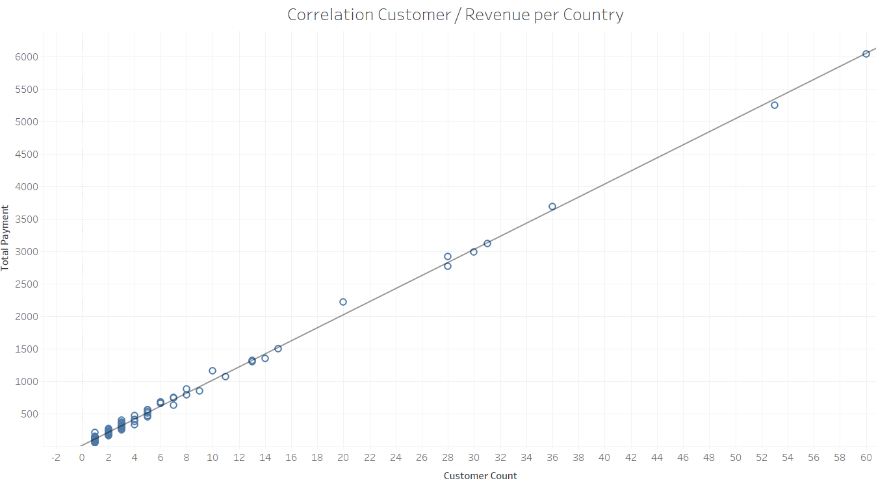
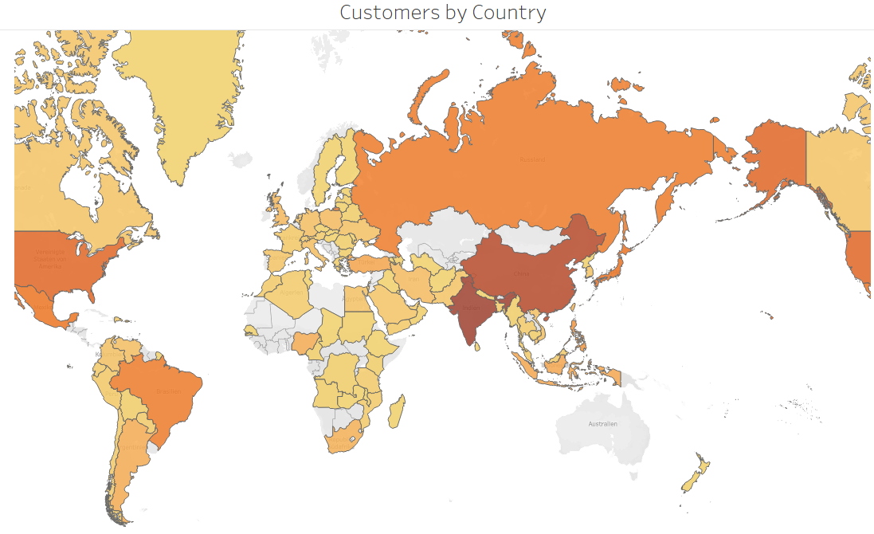
Do sales figures vary between geographic regions?
We see a strong correlation between the number of customers and its revenues per country!

Slide 10
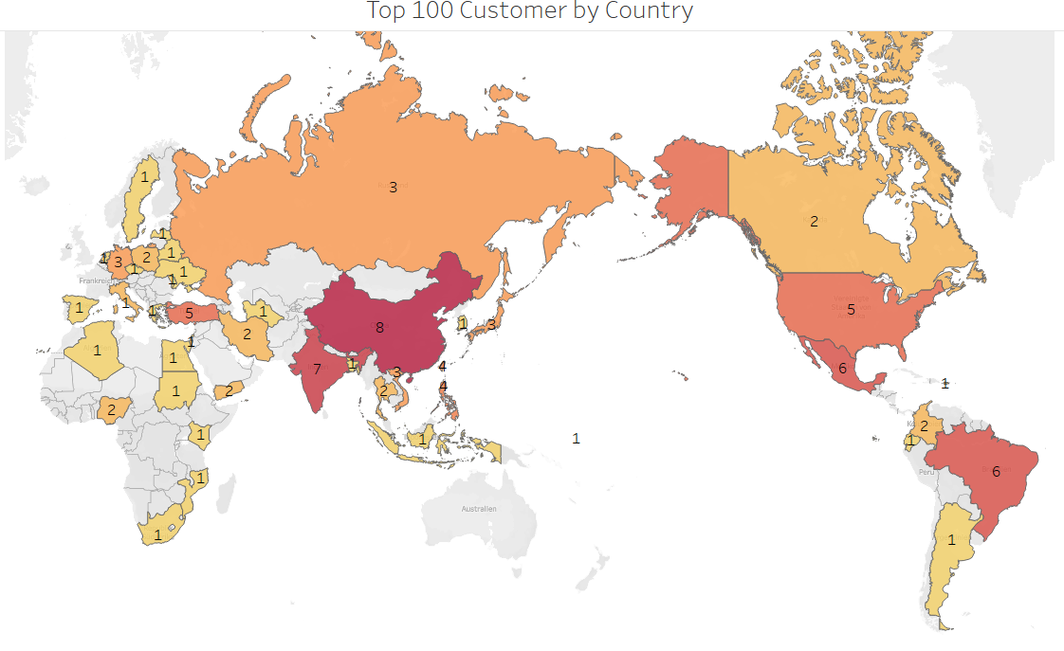
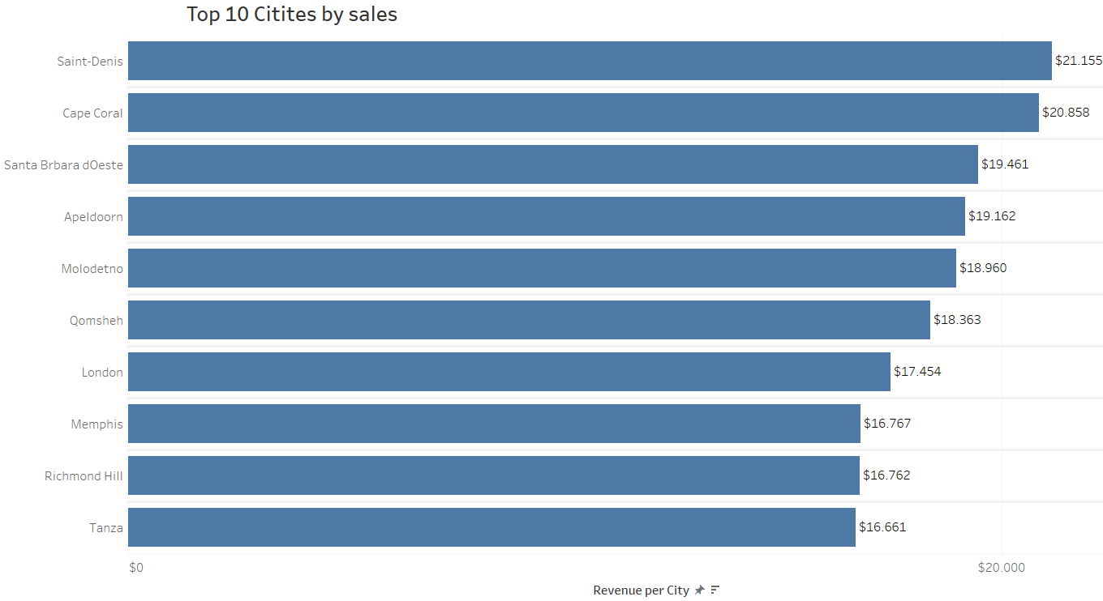
Where are customers with a high lifetime value based?

Slide 11
Recomendations
Increase our video library across all genres, Thrillers included! All genres performed equally well, relative to the numbers of titles of Rockbuster stores.
Increase our video library across all ratings! Considered the number of titles and their ratings in the store, all ratings performed relatively equal.
Focus advertising for new streaming service in India, China, United States, Japan, and Mexico!
This is where we have the most customers who provide the highest revenues.

Slide 12
Contact Information
For any further questions, comments, or feedback, don‘t hesitate to contact me under the following E-Mail:
Niklas@Rockbuster.de
Thank You!

Slide 14
Tableau Links I
Top 10 Movies by Revenue: https://public.tableau.com/app/profile/niklas.winter/viz/Top10Movies_16781021197610/revenuebyfilmdesc?publish=yes
Flop 10 Movies by Revenue: https://public.tableau.com/app/profile/niklas.winter/viz/Flop10Movies/revenuebyfilmasc?publish=yes
AVG rental duration https://public.tableau.com/app/profile/niklas.winter/viz/AVGRentalduration/AVGrental?publish=yes
Revenue by Genre https://public.tableau.com/app/profile/niklas.winter/viz/RevenuebyGenre_16781031751140/revbycategory?publish=yes
Revenue by Rating https://public.tableau.com/app/profile/niklas.winter/viz/RevenuebyRating_16781040221770/revbyrating?publish=yes
Customer per Country https://public.tableau.com/app/profile/niklas.winter/viz/CustomerperCountryRockbuster/customersbycountry?publish=yes

Slide 15
Tableau Links II
Revenue by Country: https://public.tableau.com/app/profile/niklas.winter/viz/RevenuebyCountry_16781043811610/paymentbycountry?publish=yes
Correlation number of customers and sales per region: https://public.tableau.com/app/profile/niklas.winter/viz/Correlationcountcustandsales/correlationcountcusrev?publish=yes
Top 100 customers per Country: https://public.tableau.com/app/profile/niklas.winter/viz/Top_100_customers_per_country/Top_100_cust?publish=yes
Top 10 Cities by Sales: https://public.tableau.com/app/profile/niklas.winter/viz/Top_10_cities_by_sales/Top_10_cities?publish=yes

